Slide 1
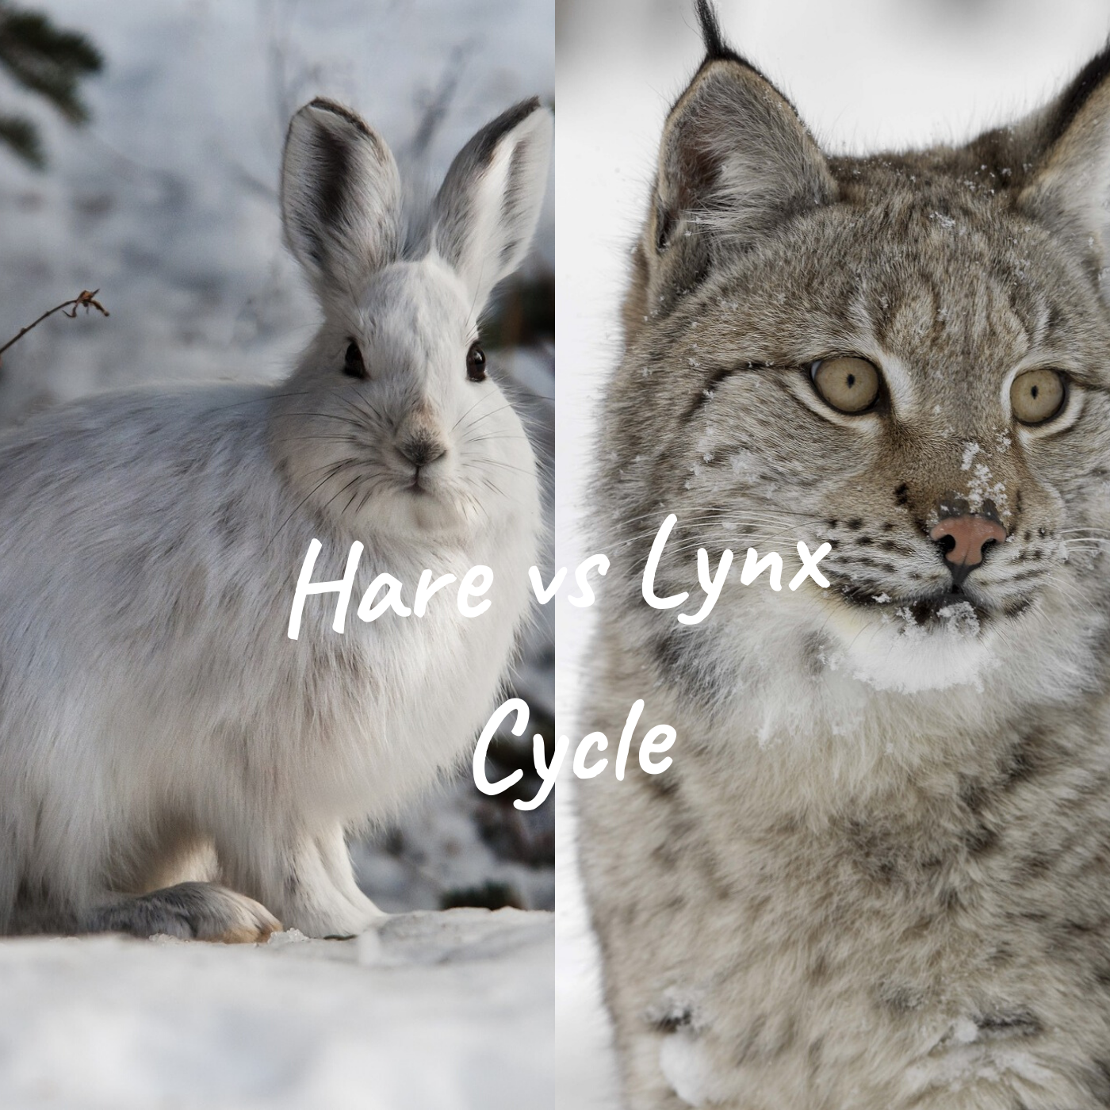
Predator – PREY Model of Canadian Lynx and Snowshoe Hare
Prof : Nav Nidhi Rajput
Date : 05/03/2022
By Abdessamad mayad
stony brook university

Slide 2
Outline
Problem statement​
Objectives/Goals​
Approach​
Results/Outcomes​
Discussion
Notes:
my presentation has the following sections …First we will see what the problem statement is. Then we will discuss the objective of our study , Then I will describe how I approached the problem. How was the problem formulated mathematically and what parameters and interaction species were taken into account.. I will also show how the problem was solved using programming tools

Slide 3
problem statement
Predator-prey models
One Specialist Models
Two Specialist Models
Why we need such models ?
To study dynamics of the animal populations
To be able to predict long-term probability of a species in a given patch of habitat.
Notes:
Predator-prey model: is a model which provide the information about relation, interaction and effects of the predator on the prey, Also densities of their population how its grow or decline
Why we need it ? Because it is used to model the population dynamics of the specialist and generalist species in a habitat and it attempts to define and predict population changes and estimates species interdependence.
One specialist models try to capture the behaviour of a single predator and two specialist models on the behaviour of two specialist species with the prey. But what are actually is a specialist species? A specialist species is a species that can only depend on a certain type of food and it needs. And when that food is not available, actually dies out.

Slide 4
Objectives/goals
Build model for two specialist species.
Provide solutions to any distribution and cycles of the hare and predator population.
Notes:
The predator prey relationship consists of the interactions between two species and their consequent effects on each other. In the predator prey relationship, one species is feeding on the other species.
“The objective of this project is to build a model and get the details of the lynxes and hares cycles according to a particular period of time. So that we would be able to investigate their life cycle Also how they will grow or decline”

Slide 5
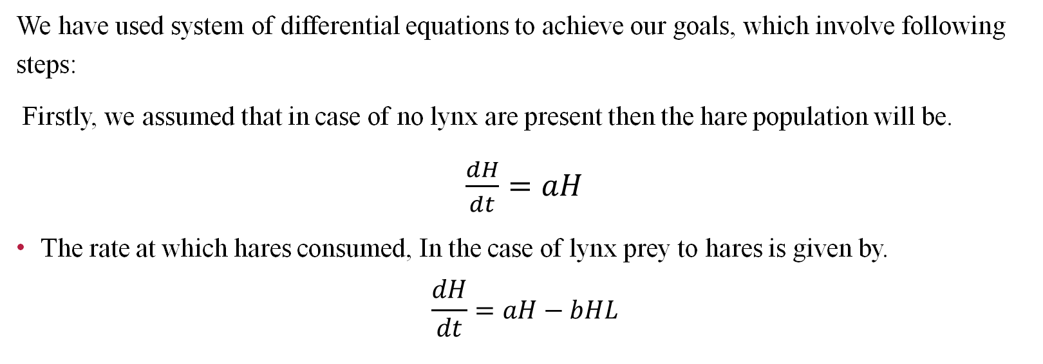
Approach
We have used system of differential equations to achieve our goals, which involve following steps:
Firstly, we assumed that in case of no lynx are present then the hare population will be.
$\frac{dH}{dt}=aH$
The rate at which hares consumed, In the case of lynx prey to hares is given by.
$$\frac{dH}{dt}=aH−bHL$$
Notes:
To achieve the goal we have used a systeme of differential equations, which involve following steps: Firstly, we calculate the population of hares in case of no lynx are present. Suppose that when there is no lynx present then the rate of reproduction of hares is proportional to their population and it will be increased exponentially. Thus the equation becomes which shows the rate change of hares population: dH/dt = aH
Where H denoted hares population.
Secondly, we calculate the rate at which hares consumed. In the case of lynx prey to hares, the rate at which hares consumed by the predator proportional to the rate at which both lynx and hares interact. So, the above equation of rate change of hares population becomes as follow:
^{dH}_{dt} =aH−bHL
In the above Equation, HL denoted the possible numbers of interactions between prey and predator (lynx and hares) population.

Slide 6
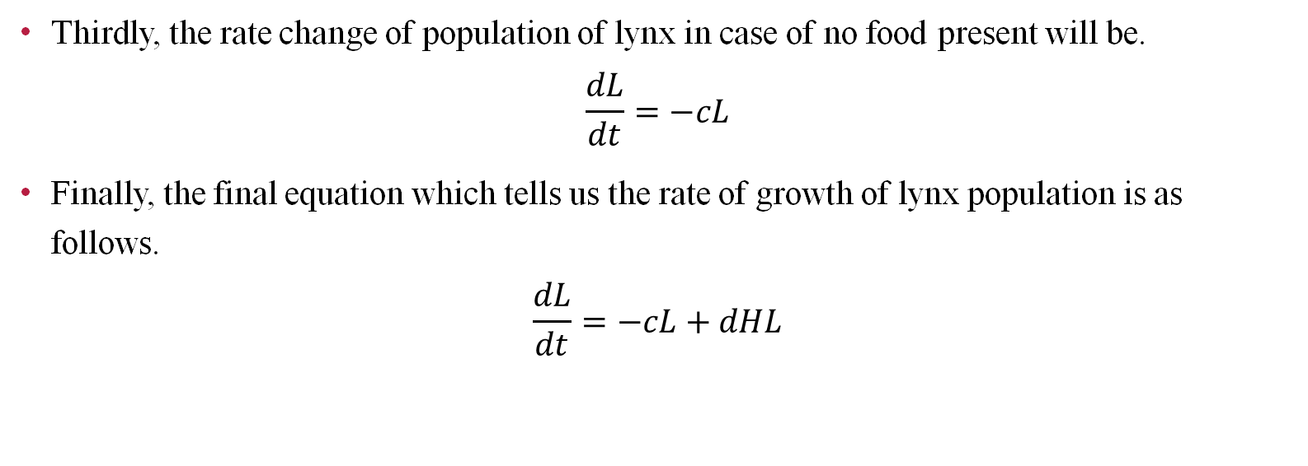
Approach
Thirdly, the rate change of population of lynx in case of no food present will be.
$$\frac{dL}{dt}=−cL$$
Finally, the final equation which tells us the rate of growth of lynx population is as follows.
$$\frac{dL}{dt}=−cL+dHL$$
Notes:
Thirdly, in case of no HARE present, the rate change of lynx population or rate of decline of lynx population is proportional to itself. The equation of rate change of lynx population is:
Dl/dt= -cl
Where L is indicate the population of lynx.
Fourthly, we calculate the rate of growth of lynx population through the following equation:
dL/dt= -cl+ dHL

Slide 7
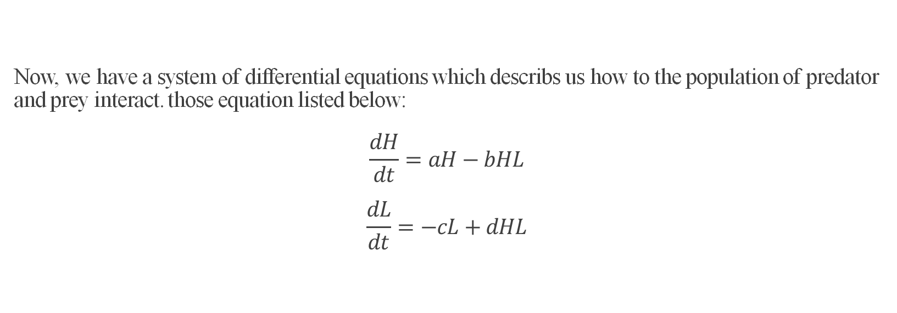
Approach
Now, we have a system of differential equations which describs us how to the population of predator and prey interact. those equation listed below:
$$\frac{dH}{dt}=aH−bHL$$
$$\frac{dL}{dt}=−cL+dHL$$
Notes:
Dh/dt refer to hare . A is the growth term , constant a multiply by current level population of hare . When there is no lynx the term
And we have our death term (b H l) WE have constant b times the current hare population level times the current population level of the lyns because the death terms of the hare deponds on the lynx eating them that’s wy we have L
For the 2nd ode we have the growth terms dhl

Slide 8
data
Open-source data of Hudson Bay Company.
Year | Population of Lynx | Population of Hare
1847 | 21000 | 49000
1848 | 12000 | 21000
1849 | 24000 | 9000
1850 | 50000 | 7000
1851 | 80000 | 5000
Notes:
we take our data from the open source data of Hudson Bay Company which monitored the population of the lynxes and the hares. The table here only shows a data of five years. But in the programme we have taken the data from 1847 till 1891.

Slide 9
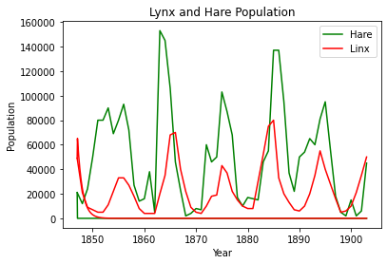
Results
Population of the prey and the predator over time.
Shows the cyclic nature of population and the interdependence of the species.
Notes:
This graph illustrate the relationship between the size of the hare and the size of the lynx population. Notice how the lynx ‘s pattern closely follows the hares pattern . Why do we have that ? What happening is complex the lynx n hares have a predator-prey relationship. Disease food supply and other predators are variables in this complex relationship. The flux in this cyclic relationship is what allows for the ecosystem dynamic to work. Without flux vegetation wouldn’t not have a chance to recover from the hares population’s continuous eating and without the hair population could no longer exist in its habitat and therefore neither the lynx population that depends upon the hare population for food
Every 10 year or so the hares’ reproduction rate increase . As more hares are born they eat more of their food supply , so the population size grows, the lynx population size begins to increase in response because there are so many hares . Means that other predators begin to hunt them then the population size starts to go in a steep decline in results the lynx populations also begins to decline

Slide 10
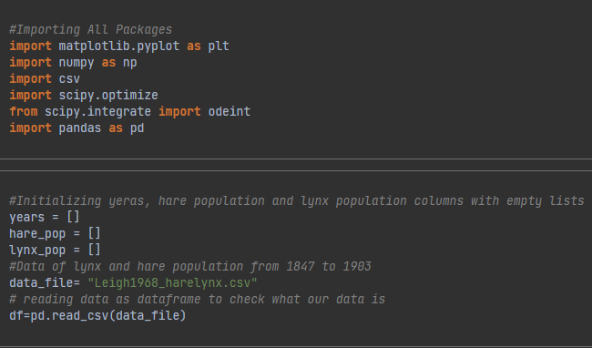
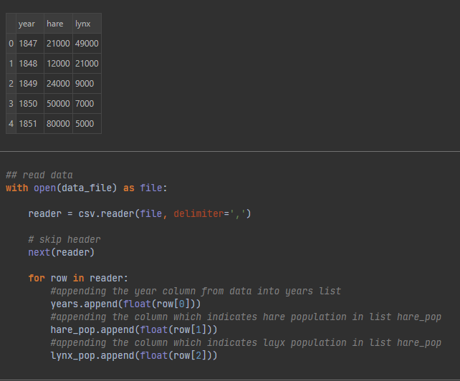
CoDE Snapshots
Initializing and reading data
\
Notes:
Here are some snapshots of the code that I have written to calculate the population. I have read the Population statistics from the CSV file provided. I have also defined the variables and parameters. That have been used in the calculation of the differential equations. I calculated the population error and plotted the results.

Slide 11
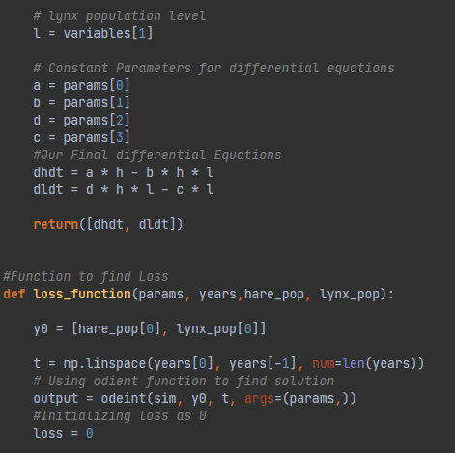
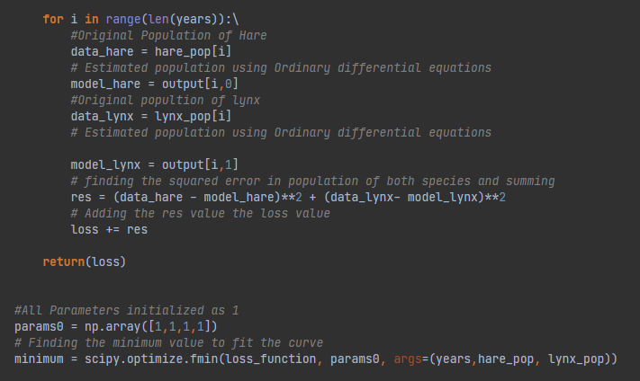
CoDE Snapshots
Defining variables and parameters
Calculating population error

Slide 12
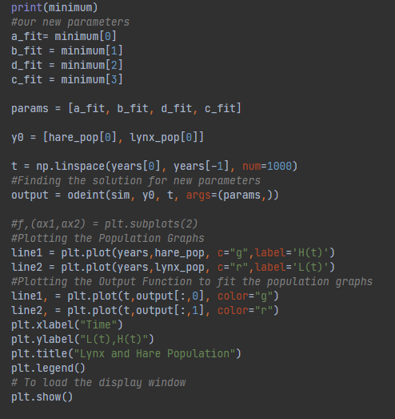
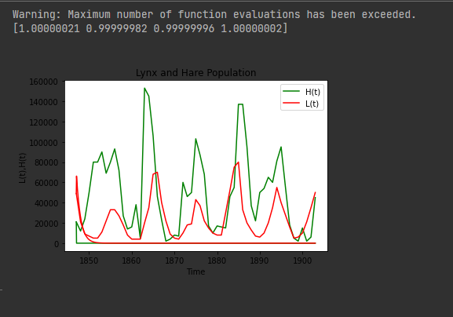
CoDE Snapshots Optimizing and plotting

Slide 13
Discussion
We studied the population dynamics of the prey and the predator in a habitat using differential equations.
Results show close dependence of the prey and predator over each other.
Cyclic nature over time.
Notes:
In the presence of predators, many prey species change their behaviour due to predation risk and show a variety of anti-predator responses, which incorporates foraging activity, habitat alterations, vigilance and some physiological changes, etc. It is also observed that due to fear of predation risk, the reproduction rate of the scared prey decreases.
In this project we have observed that how the effect of one specie in predator prey model effects the population of each other. We observed this behavior on already available open source data of Hudson Bay Company about the population of Canadian lynx and the snowshoe hare from 1847 to 1903.
Our study shows that when there are less predators then the population of prey will be rise at a very high rate. Similarly, the rate at which predator prey on a particular specie is proportional to the population of the species interacting.
On the other hand, if food availability is less means that there is less amount of prey, then predator population will decline due to hunger. Also the rate at which a predator born is proportional to the amount of eating of the prey. These all hypothesis was modeled using differential equations.

Slide 14

Thank You

Slide 15


